Slide 1




Chapter 6: Entity-Relationship Model

Slide 2



Chapter 6: Entity-Relationship Model
Design Process
Modeling
Constraints
E-R Diagram
Design Issues
Weak Entity Sets
Extended E-R Features
Design of the Bank Database
Reduction to Relation Schemas
Database Design
UML

Slide 3

Modeling
A database can be modeled as:
a collection of entities,
relationship among entities.
An entity is an object that exists and is distinguishable from other objects.
Example: specific person, company, event, plant
Entities have attributes
Example: people have names and addresses
An entity set is a set of entities of the same type that share the same properties.
Example: set of all persons, companies, trees, holidays

Slide 4




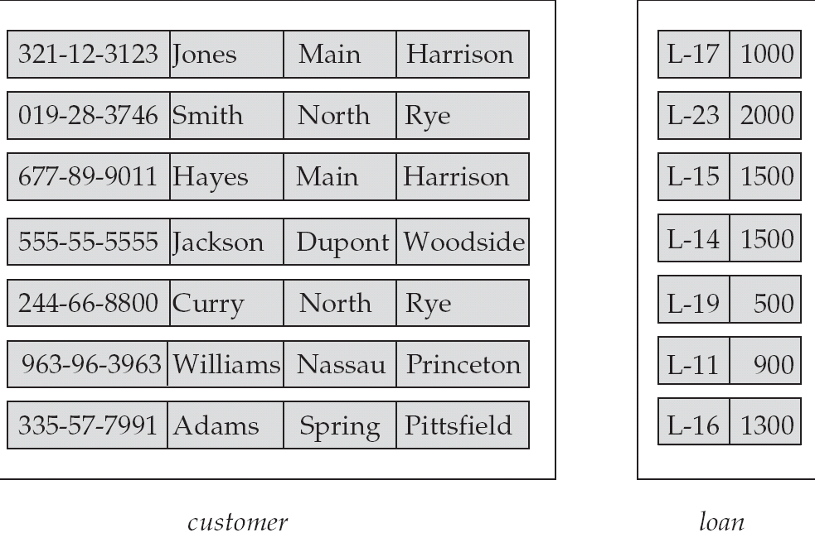
Entity Sets customer and loan
customer_id | customer_ customer_ customer_ | loan_ | amount
 | name street city | number

Slide 5

Relationship Sets
A relationship is an association among several entities Example:
Hayes
customer entity
depositor
relationship set
A-102
account entity
A relationship set is a mathematical relation among n ≥ 2 entities, each
taken from entity sets
{(e₁, e₂, … e_{n}) | e₁ ∈ E₁, e₂ ∈ E₂, …, e_{n} ∈ E_{n}}
where (e₁, e₂, …, e_{n}) is a relationship
Example:
(Hayes, A-102) ∈ depositor

Slide 6


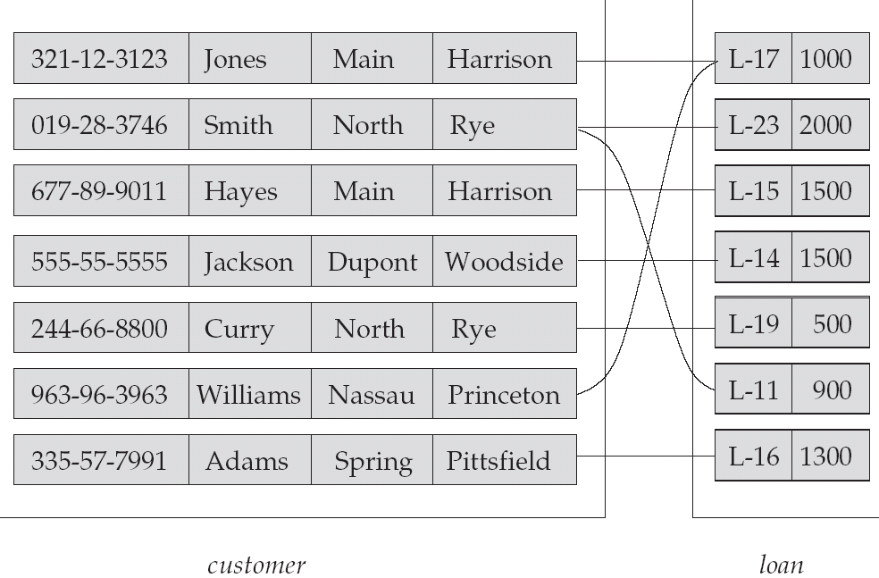
Relationship Set borrower

Slide 7
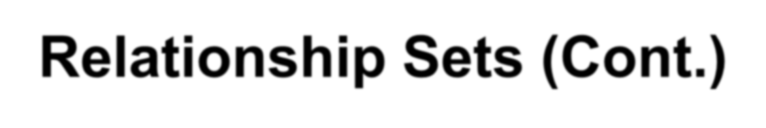
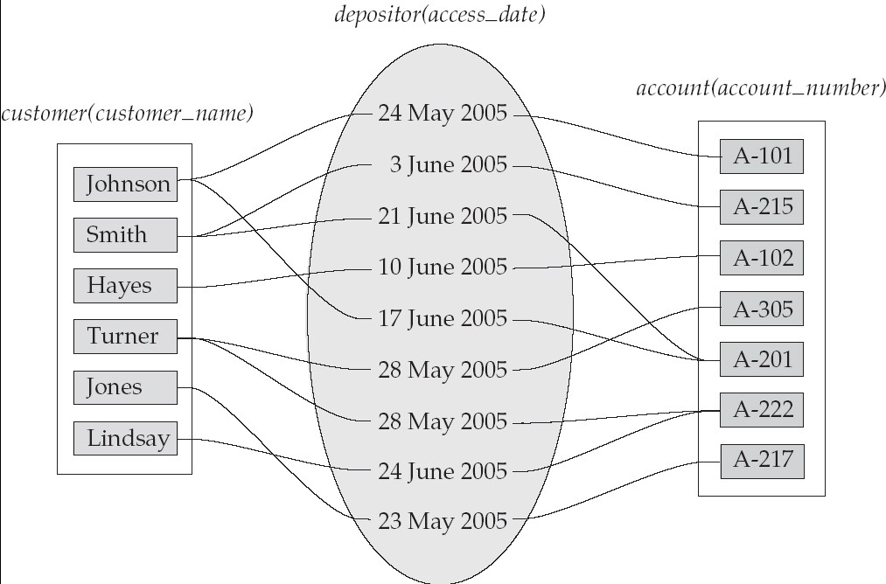
Relationship Sets (Cont.)
An attribute can also be property of a relationship set.
For instance, the depositor relationship set between entity sets
customer and account may have the attribute access-date

Slide 8

Attributes
An entity is represented by a set of attributes, that is descriptive properties possessed by all members of an entity set.
Example:
customer = (customer_id, customer_name, customer_street, customer_city )
loan = (loan_number, amount )
Domain – the set of permitted values for each attribute
Attribute types:
Simple and composite attributes.
Single-valued and multi-valued attributes
 Example: multivalued attribute: phone_numbers
Derived attributes
 Can be computed from other attributes
 Example: age, given date_of_birth

Slide 9


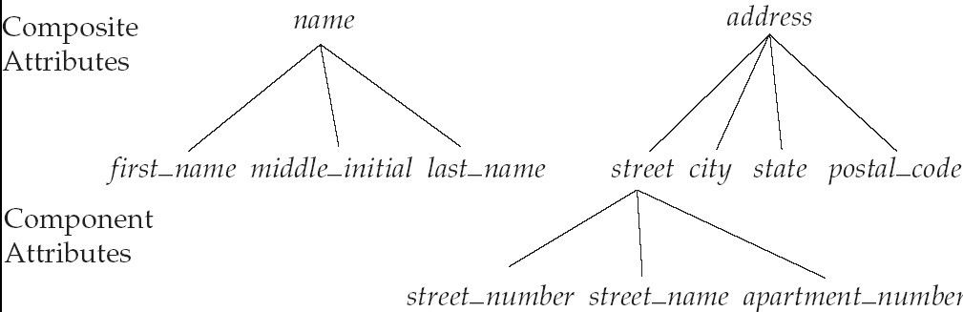
Composite Attributes

Slide 10




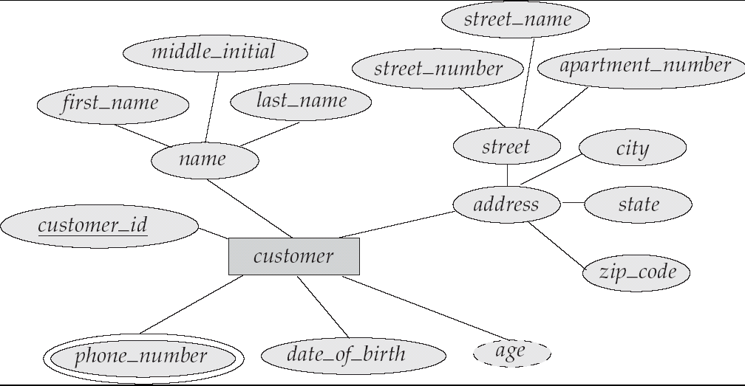
E-R Diagram With Composite, Multivalued, and Derived Attributes

Slide 11

Mapping Cardinalities
Express the number of entities to which another entity can be associated via a relationship set.
Most useful in describing binary relationship sets.
For a binary relationship set the mapping cardinality must be one of the following types:
One to one
One to many
Many to one
Many to many

Slide 12
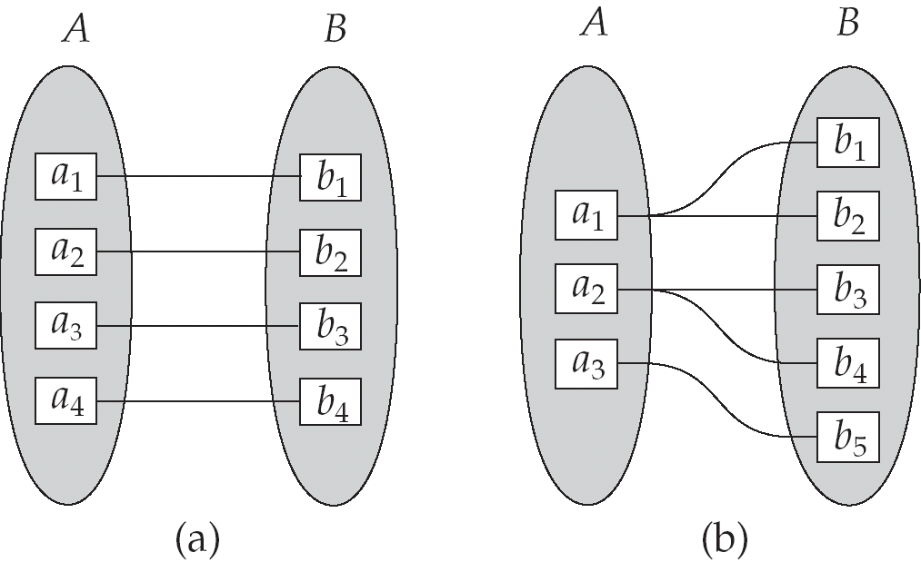
Mapping Cardinalities
One to one One to many
Note: Some elements in A and B may not be mapped to any
elements in the other set

Slide 13

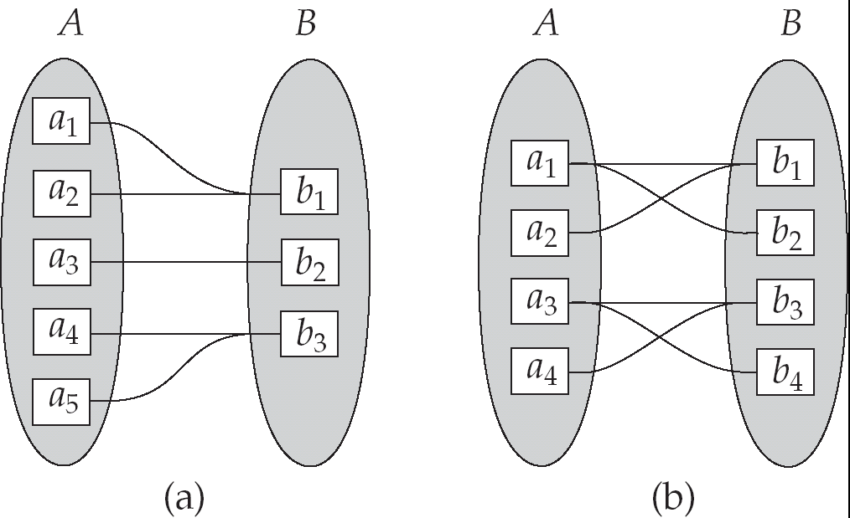
Mapping Cardinalities
Many to one Many to many
Note: Some elements in A and B may not be mapped to any elements in the other set

Slide 14




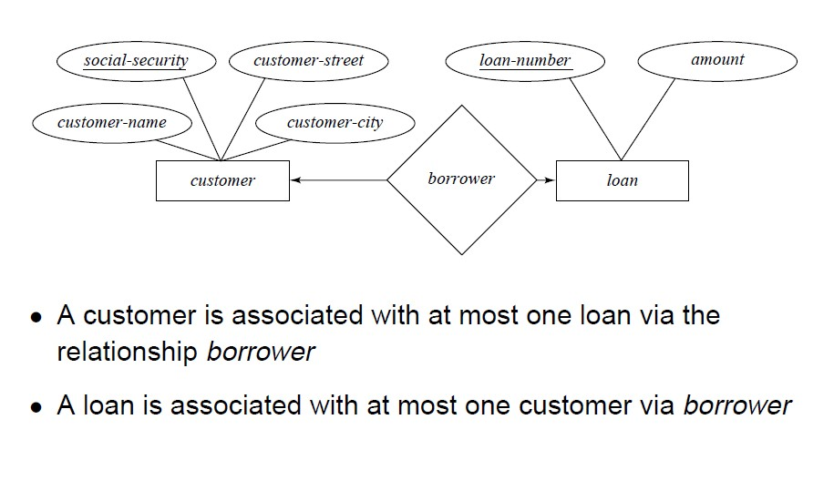
One-To-One Relationship

Slide 15







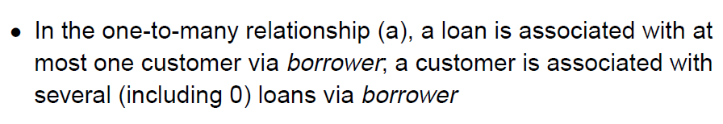
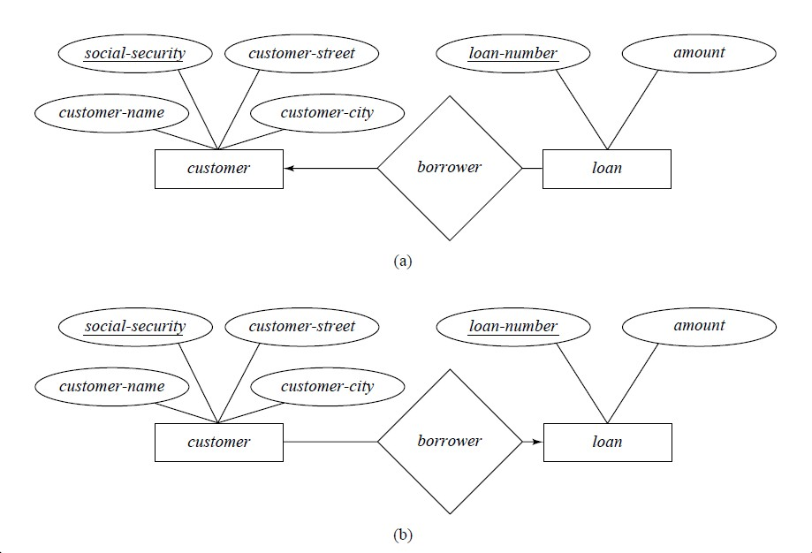
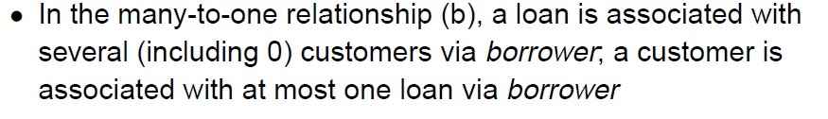
One-To-Many and Many-to-One Relationships

Slide 16


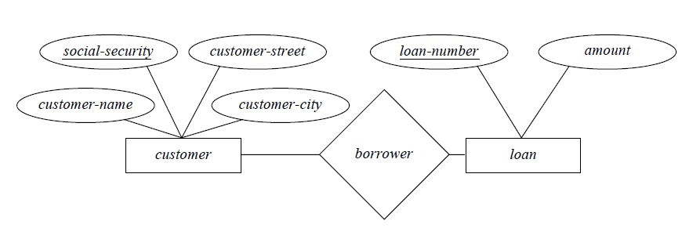
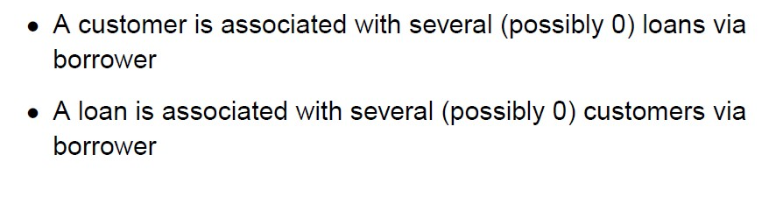
Many-To-Many Relationship

Slide 17

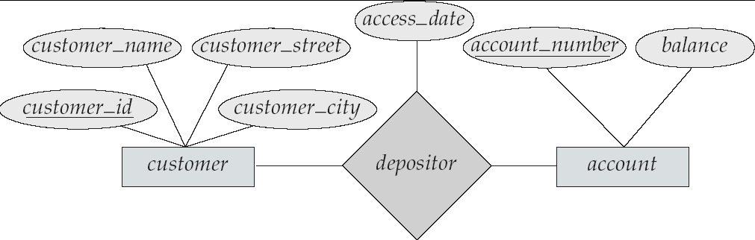
Relationship Sets with Attributes

Slide 18




E-R Diagrams
An ER diagram is useful in mapping the real world things into a conceptual schema.
It has following major components:
■
(Rectangle) : represent entity set.
■
(Ellipse) : represent attribute
(Double ellipses) : represent multivalued attribute.
(Dashed ellipse) : denote derived attributes.
: Underline indicates primary key attributes
■
(Diamond) : represent relationship set.
■
(Line) : link attributes to entity sets and entity sets to relationship sets.

Slide 19

Example 1
Draw an ER diagram to model the application with the following assumptions:
Each student has an ID, name, age and CGPA
Each course has an ID, name, Credit hours
Students in courses receive a grade.

Slide 20
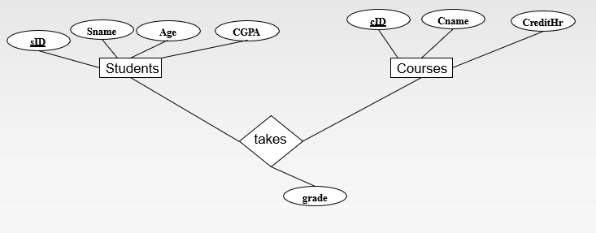
Example 1

Slide 21

Example 2
Draw an ER diagram to model the application with the following assumptions:
Each customer has a name, a permanent address, and a social security number.
Each customer can have multiple phone numbers, and the same phone number may be shared by multiple customers.
A customer can own multiple accounts, but each account is owned by a single
customer.
Each account has an account number, a type (such as saving, checking, etc), and a balance.
The bank issues an account statement for each account and mails it to its account owner every month. As time goes on, there will be multiple statements of the
same account.
Each statement has an issued date and a statement ID. All the statements of the same account have different statement IDs, but two different accounts could have statements with the same statement ID. For example, it is possible that account A has a statement with ID `123', while account B has another statement with the same ID `123'.

Slide 22

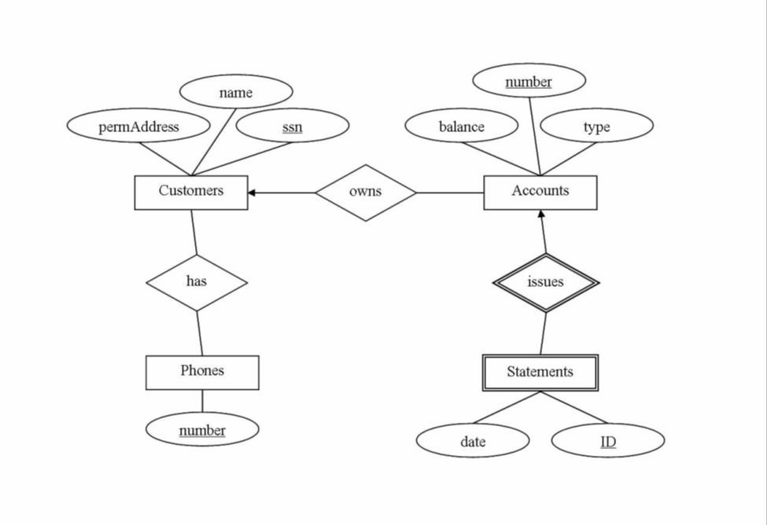
ER example

Slide 23

Classification of Entity sets
There are two types of entity sets. They are-
Strong Entity Set
Weak Entity Set

Slide 24

Strong Entity Set
Its existence doesn’t depend on other entity.
It has a primary key.

Slide 25

Weak Entity Sets
An entity set that does not have a primary key is referred to as a weak entity set.
The existence of a weak entity set depends on the existence of a
identifying entity set
it must relate to the identifying entity set via a total, one-to-many
relationship set from the identifying to the weak entity set
Identifying relationship depicted using a double diamond
The discriminator (or partial key) of a weak entity set is the set of attributes that distinguishes among all the entities of a weak entity set.
The primary key of a weak entity set is formed by the primary key of the strong entity set on which the weak entity set is existence dependent, plus the weak entity set’s discriminator.

Slide 26
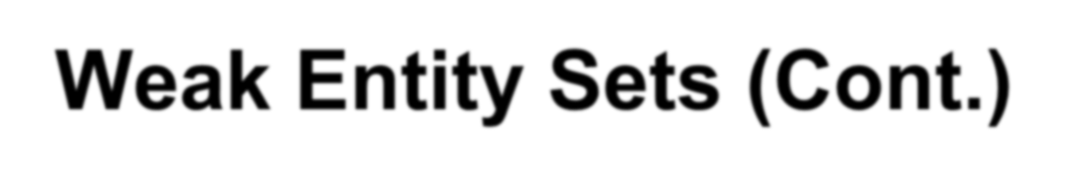

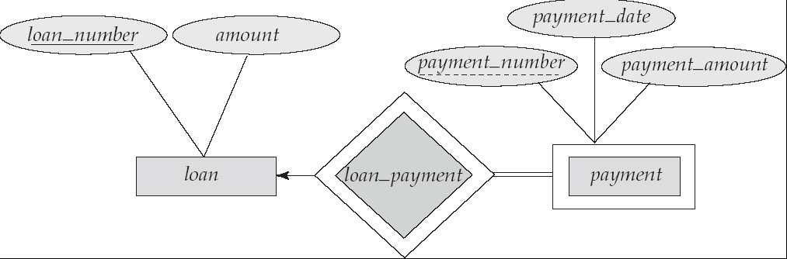
Weak Entity Sets (Cont.)
We depict a weak entity set by double rectangles.
We underline the discriminator of a weak entity set with a dashed line.
payment_number – discriminator of the payment entity set
Primary key for payment – (loan_number, payment_number)

Slide 27

More Weak Entity Set Examples
In a university, a course is a strong entity and a course_offering can be modeled as a weak entity
The discriminator of course_offering would be semester (including year) and section_number (if there is more than one section)
If we model course_offering as a strong entity we would model
course_number as an attribute.
Then the relationship with course would be implicit in the
course_number attribute

Slide 28
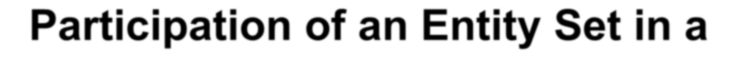

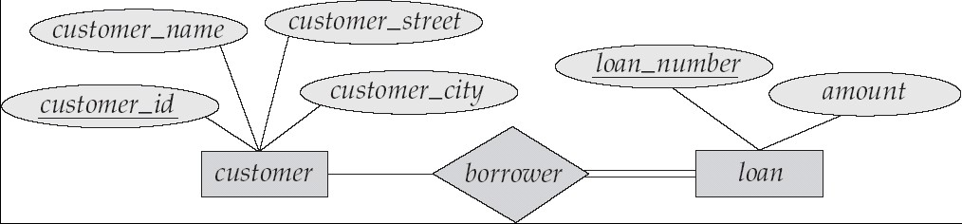
Participation of an Entity Set in a Relationship Set
Total participation (indicated by double line): every entity in the entity set participates in at least one relationship in the relationship set
E.g. participation of loan in borrower is total
 every loan must have a customer associated to it via borrower
Partial participation: some entities may not participate in any relationship in
the relationship set
Example: participation of customer in borrower is partial

Slide 29
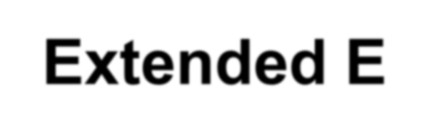

Extended E-R Features: Specialization
Top-down design process;
We create subgroups within an entity set that are distinctive from other entities in the set -this process is known as specialization.
These subgroups become lower-level entity sets and may have attributes or participate in relationships that do not apply to the higher-level entity set.
A triangle component labeled ISA ( ISA ) is used to show specialization.
ISA stands for “is a”(E.g. customer “is a” person).
Attribute inheritance – a lower-level entity set inherits all the attributes and relationship participation of the higher-level entity set to which it is linked.
The ISA relationship is also known as “superclass-subclass” relationship.
■

Slide 30

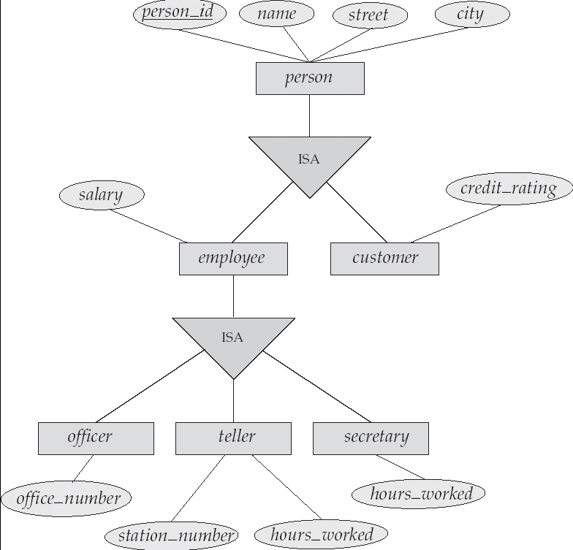
Specialization Example

Slide 31

Extended ER Features: Generalization
A bottom-up design process
Here, multiple entity sets are combined into a higher-level entity set on the basis of common features - this process is known as generalization .
Specialization and generalization are simple inversions of each other and they are represented in an E-R diagram in the same way.
The terms specialization and generalization are used interchangeably.

Slide 32
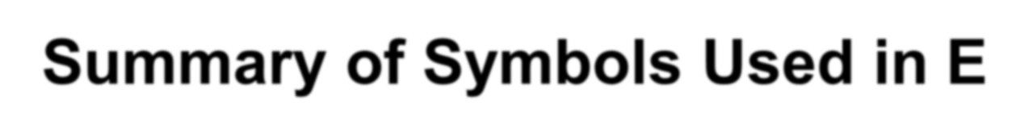


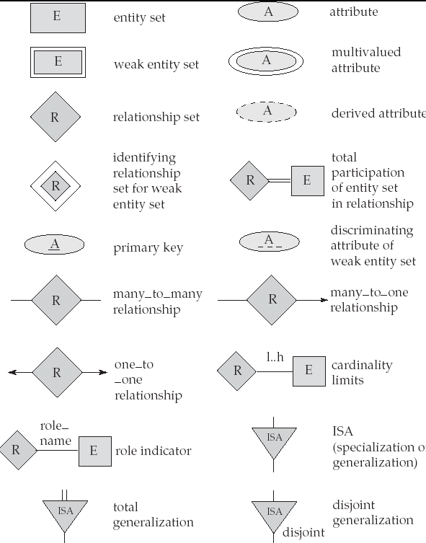
Summary of Symbols Used in E-R Notation

Slide 33
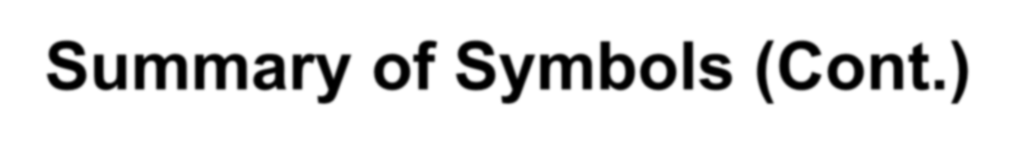
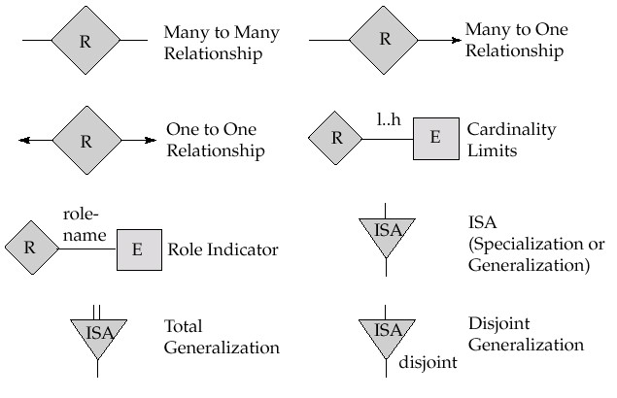
Summary of Symbols (Cont.)

